Slide 1
Dewar Communication Cable Part 1

Slide 2
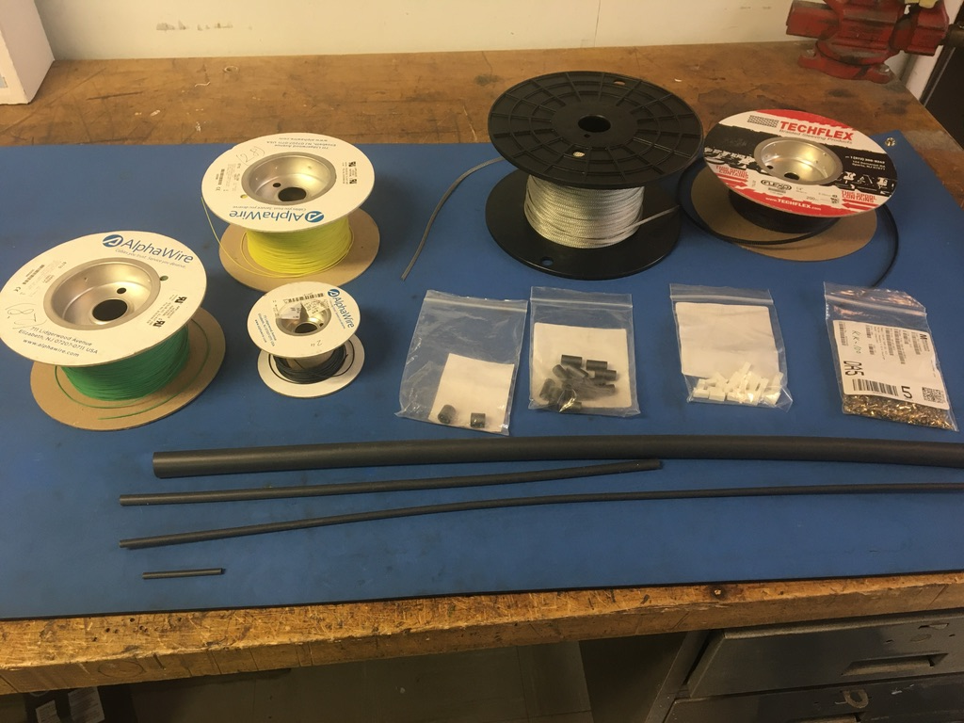
Materials

Slide 3
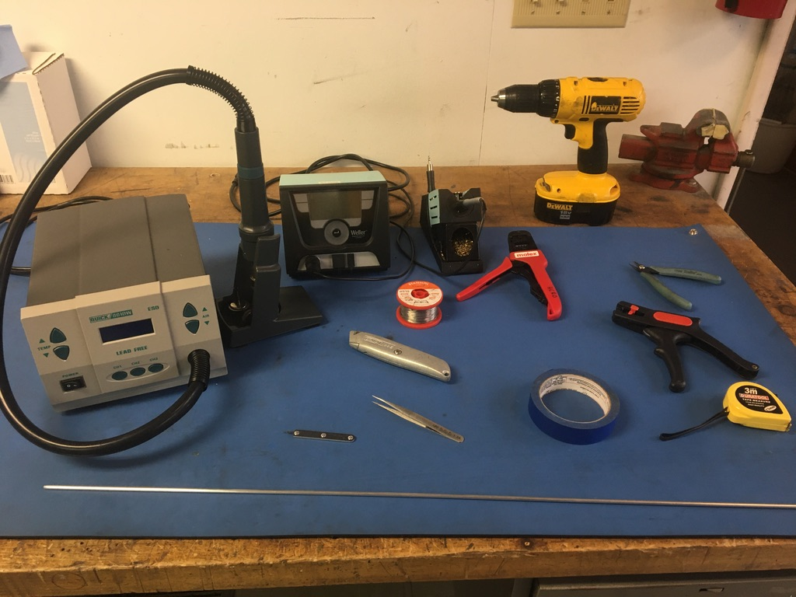
Tools

Slide 4
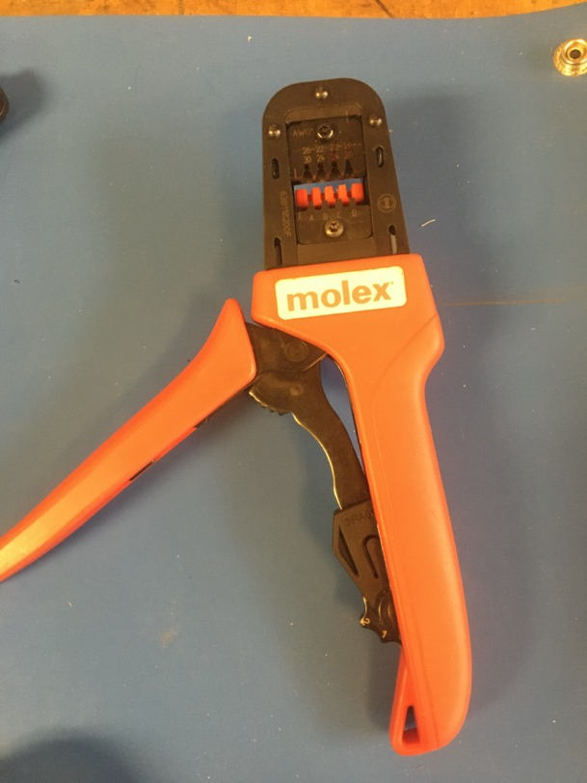
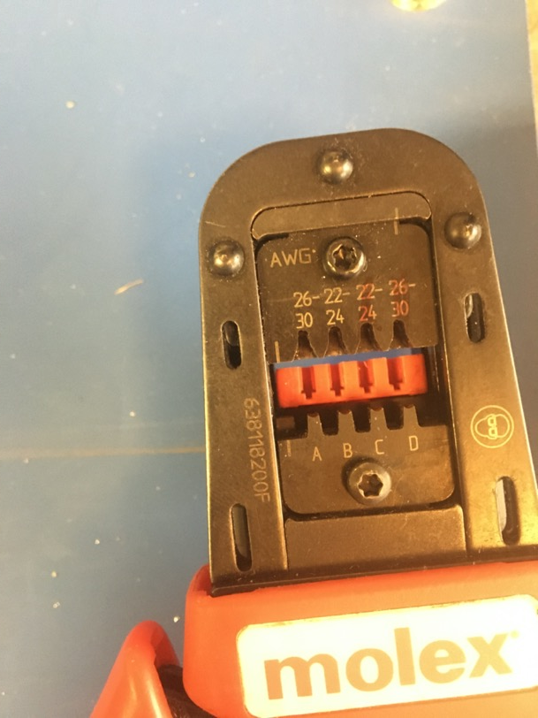
KK 254 Crimping Tool

Slide 5
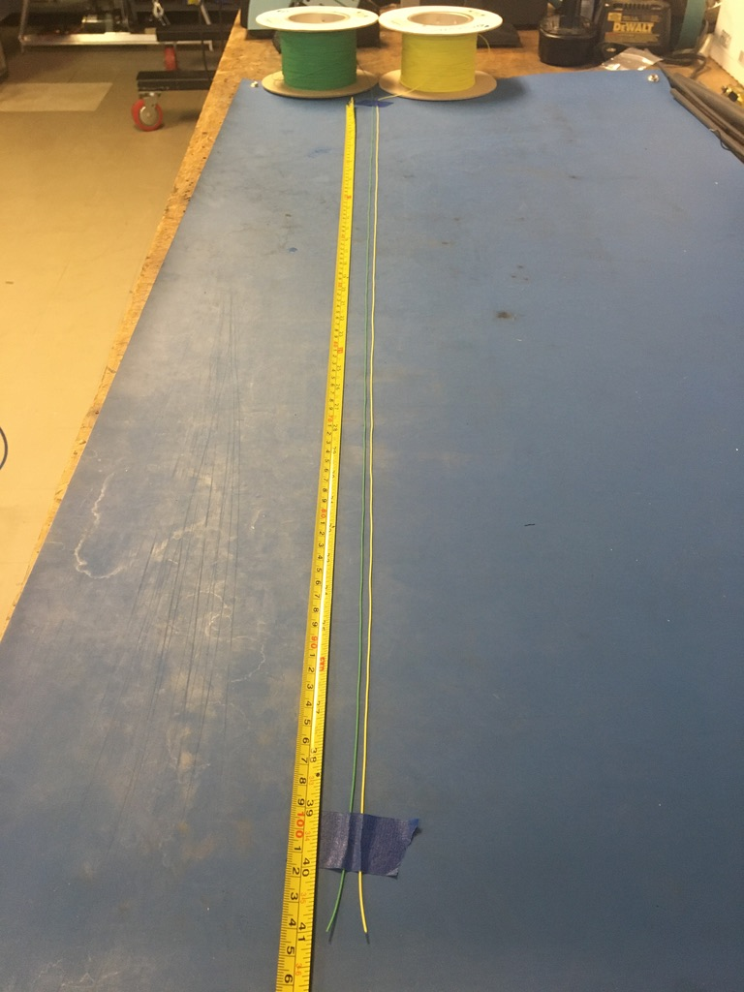
Measure out and cut 41 inches of yellow and green 28 awg wire.

Slide 6
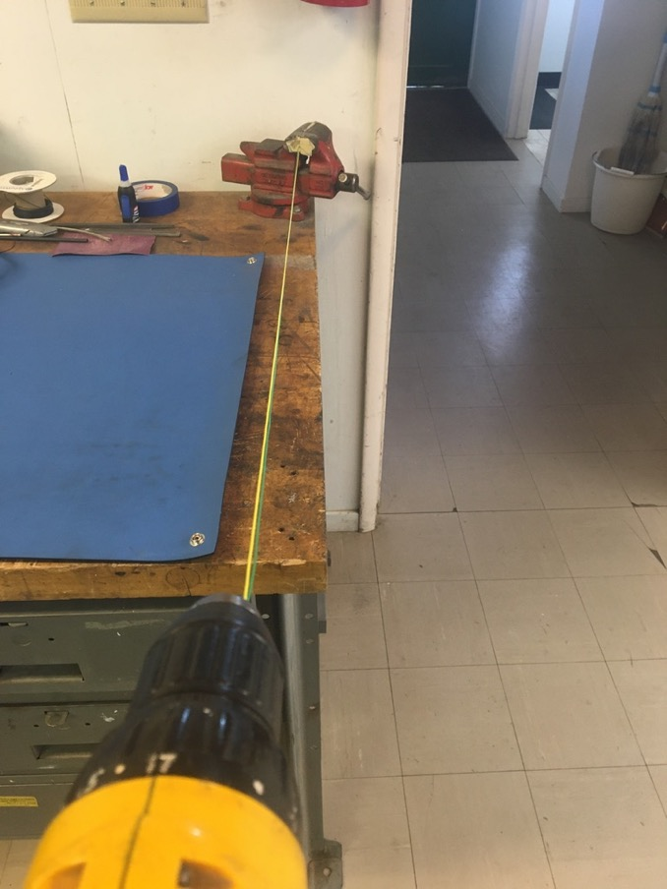
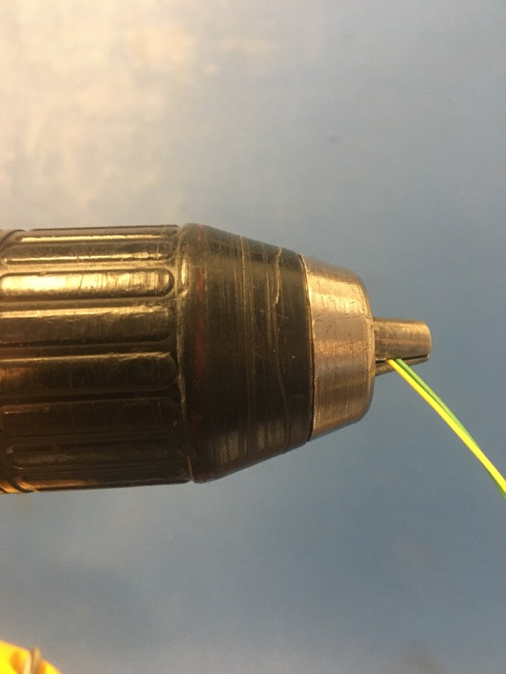
To make the twisted pair, line the vise with masking tape. Put one end of the yellow and green wires into the vise and the other into the drill. Run the drill till the wires are sufficiently twisted (for reference see the next slide).

Slide 7
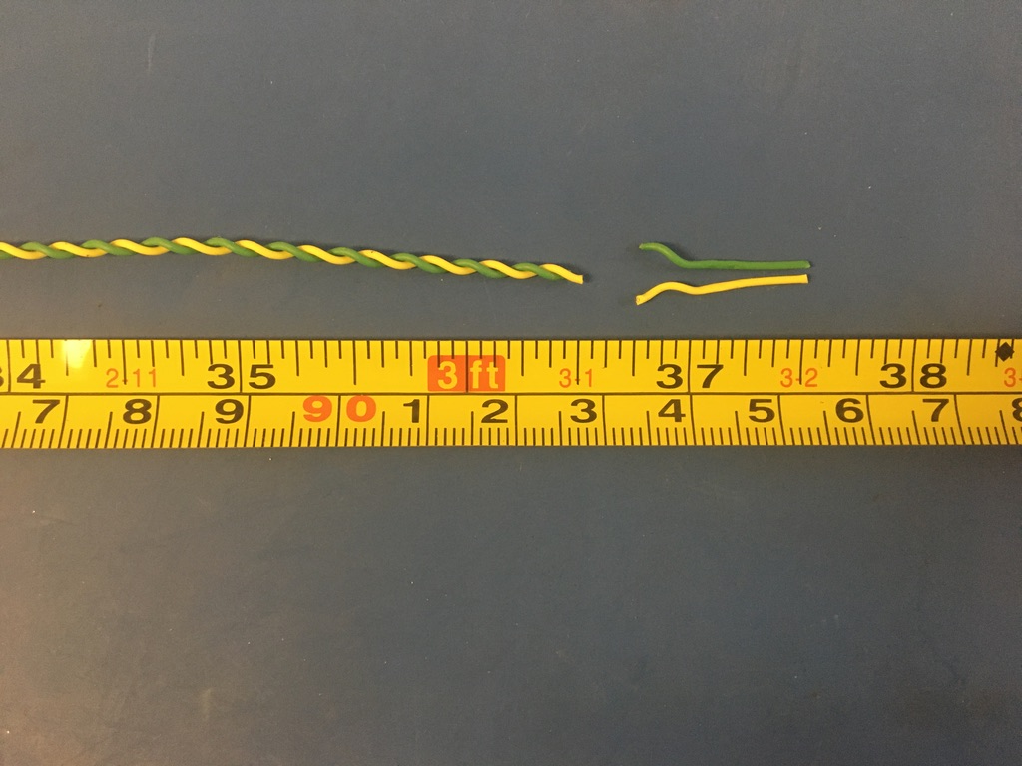
Trim the ends of the twist pair where they were in the vise and drill. Once trimmed, it should measure about 36.5 inches.

Slide 8
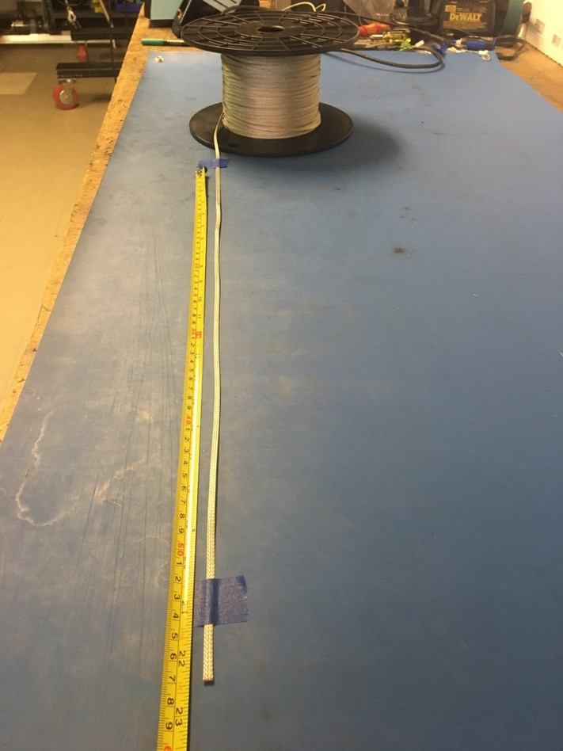
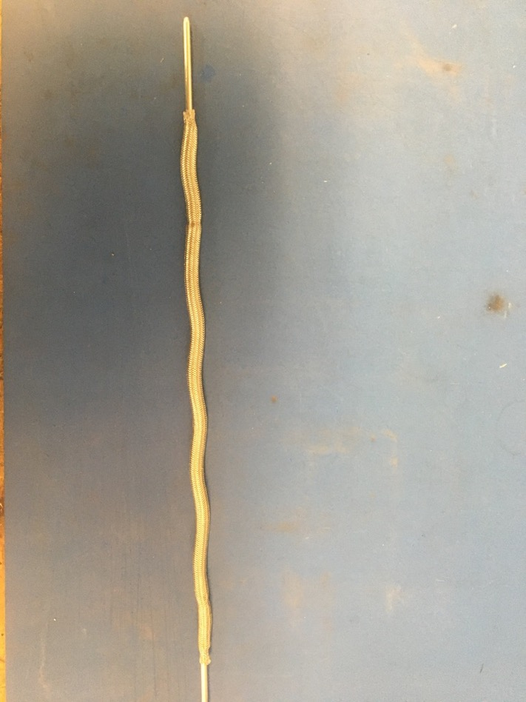
Measure out 22.5 inches of the 1/8th metal braid. Expand it using the metal rod.

Slide 9
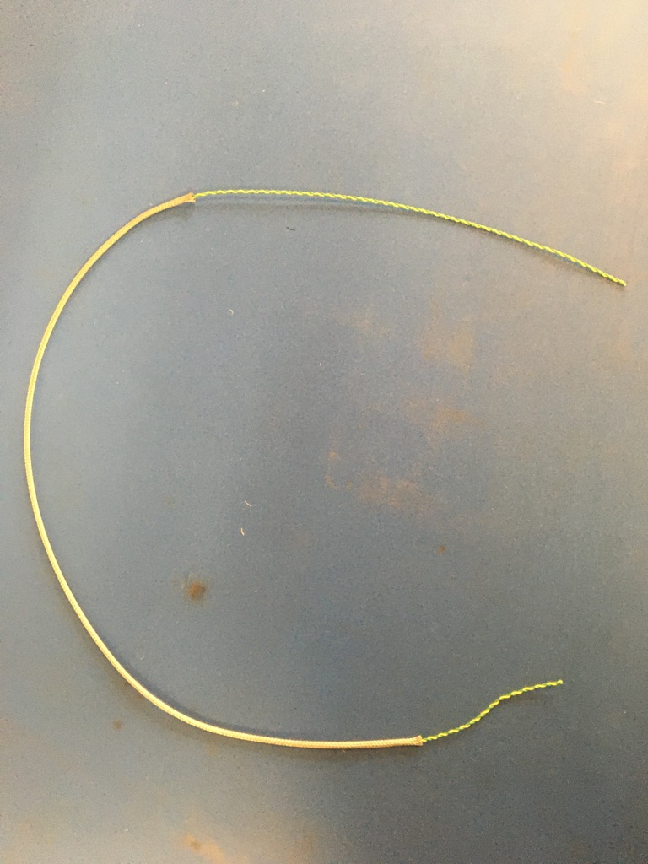
Put the twisted pair into the expanded metal braid as shown.

Slide 10
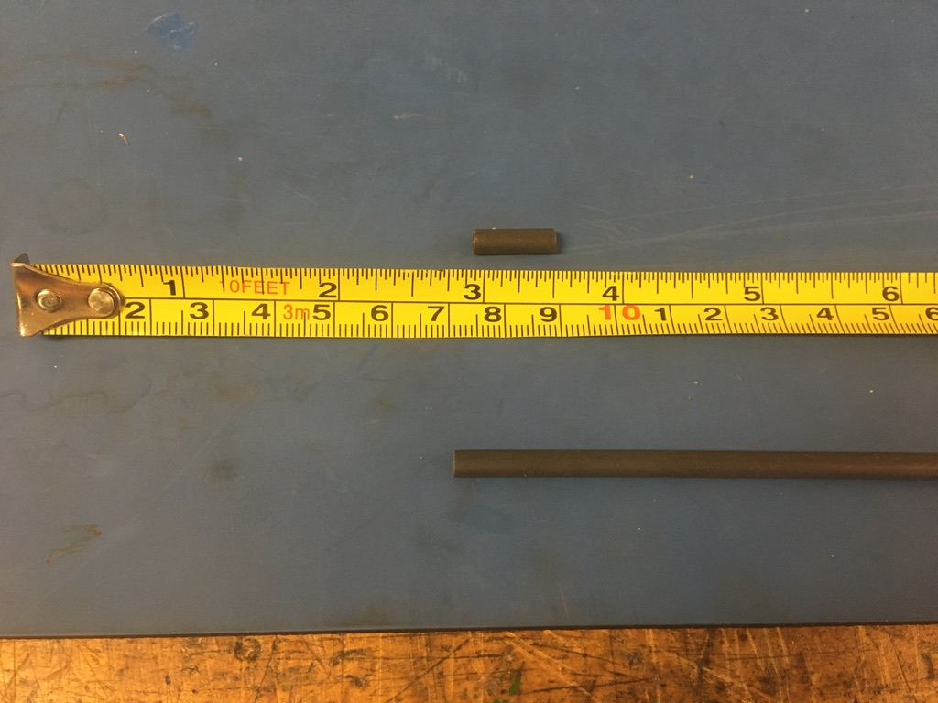
Measure out and cut two lengths of 4.8mm adhesive shrink tube each .5in long.

Slide 11
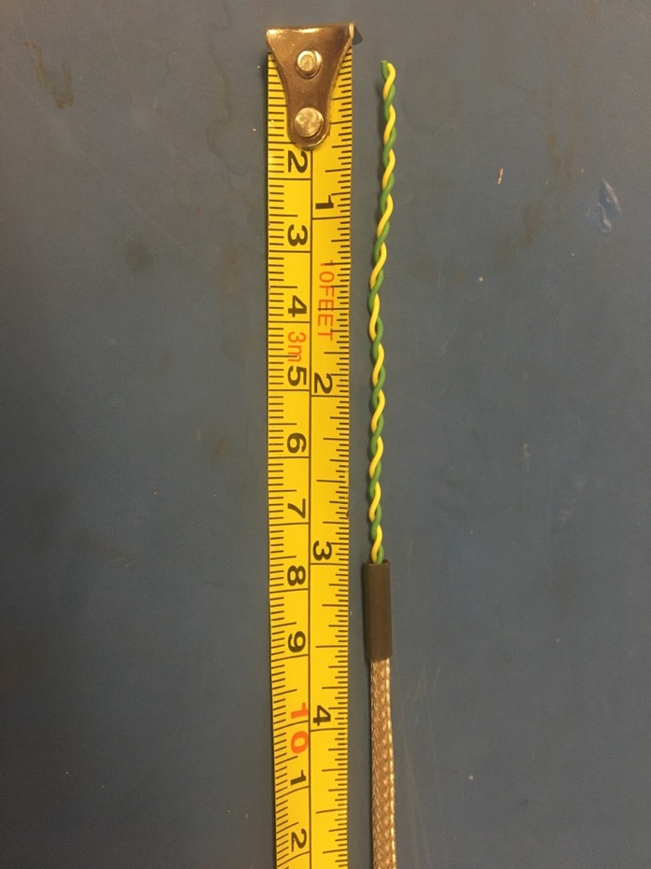
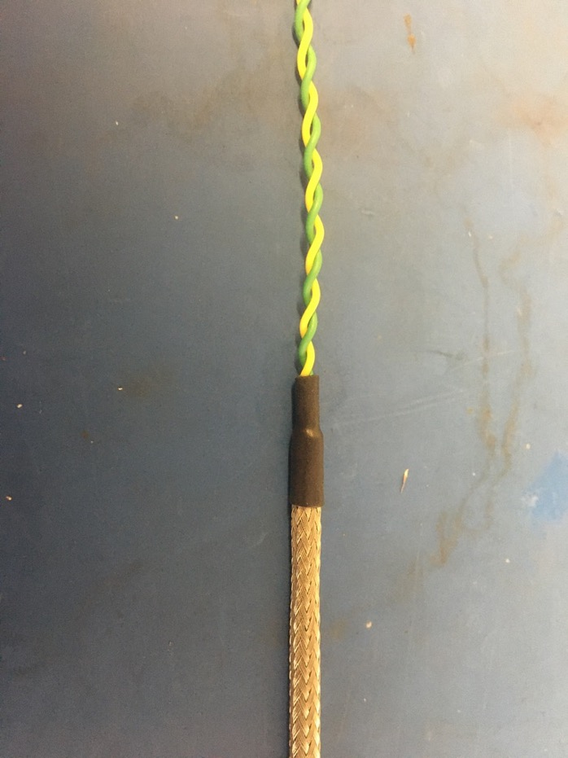
Put one piece of the shrink tube onto the end of the metal braid where the wires sticking out are shorter. Place the shrink tube such that the metal braid ends midway through it. The wires should measure 3 inches long. Apply the heat gun to the shrink tube.

Slide 12
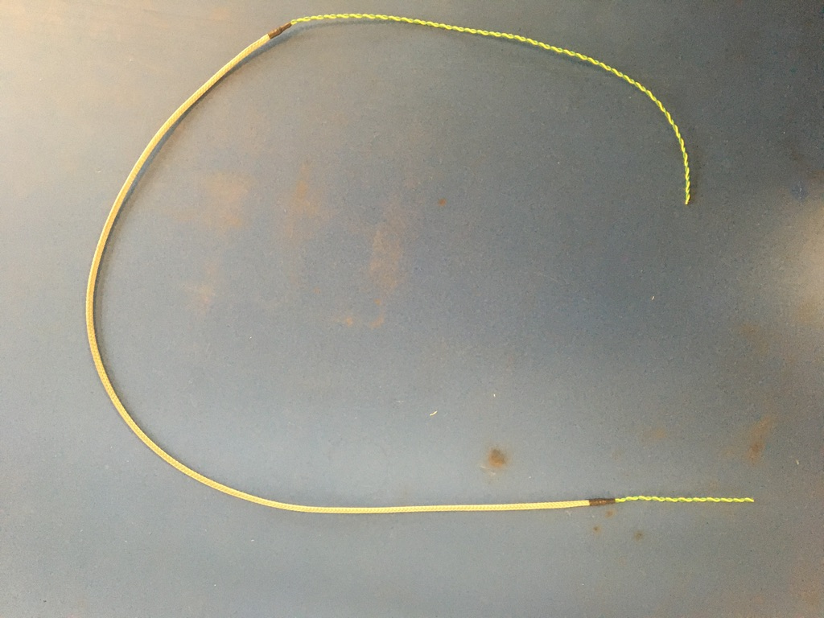
Repeat the process on the previous slide on the other end of the metal braid (though the wire does not need to be measured on this end). Thus far, the wire harness should appear as shown.

Slide 13
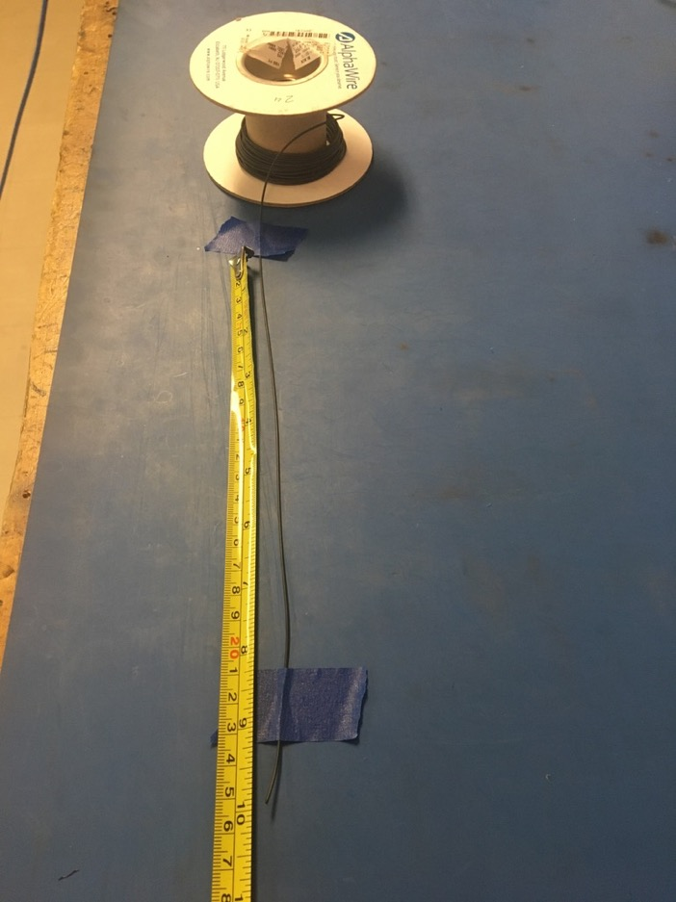
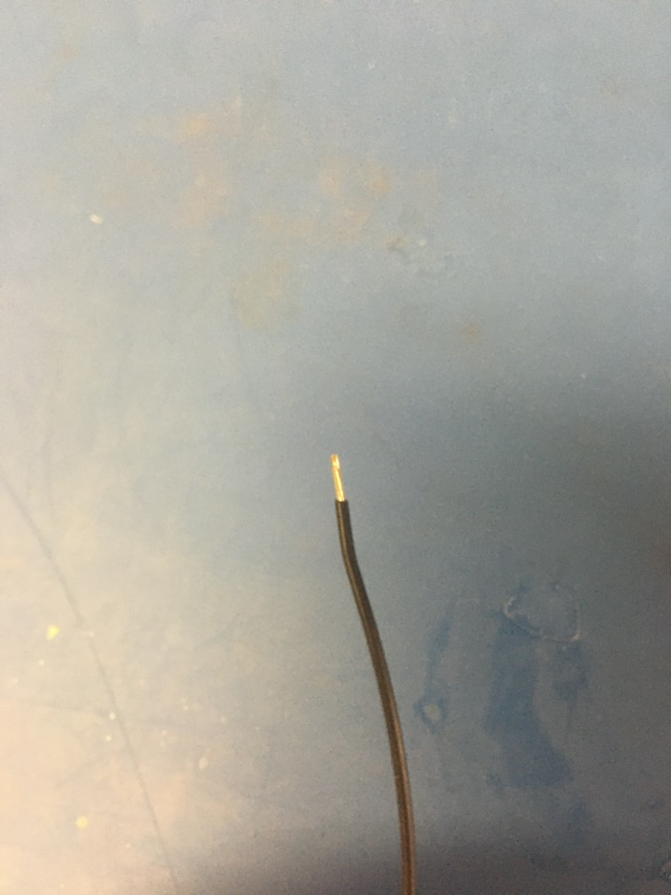
Measure out and cut 10 inches of black 24 awg wire. Strip 3-4mm off one end.

Slide 14
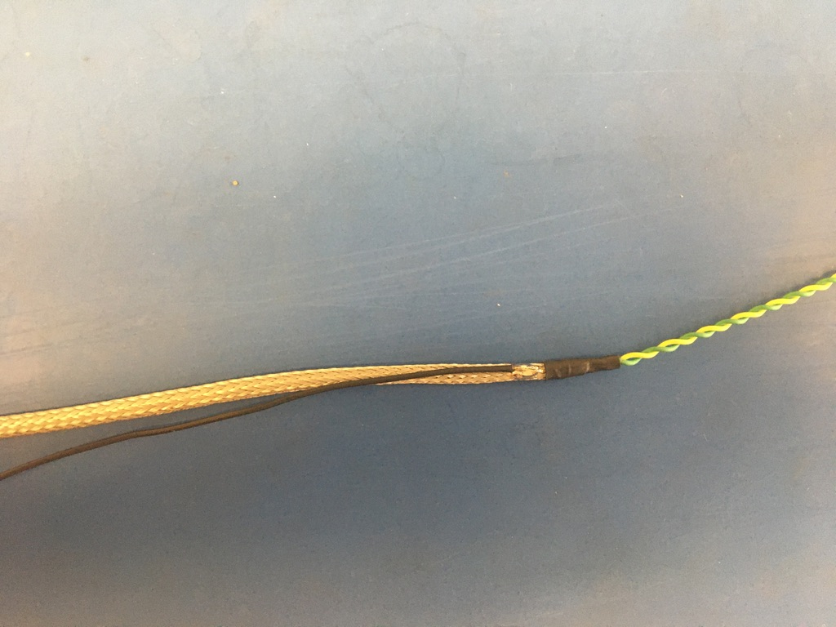
Solder the stripped end of the black wire onto the metal braid near the shrink tube joint with the longer length of wire (the end that was not measured). The black wire should be soldered so the that its length runs with that of the metal braid.

Slide 15
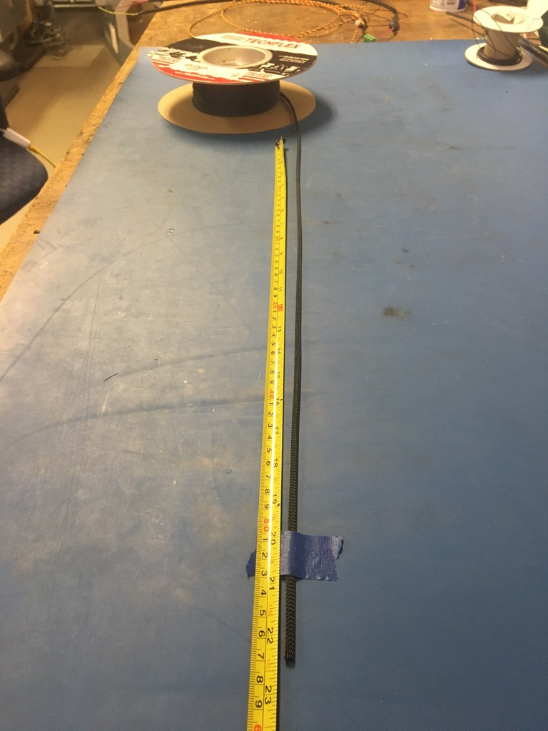
Measure out and cut 22.5 inches of 1/4th plastic braid.

Slide 16
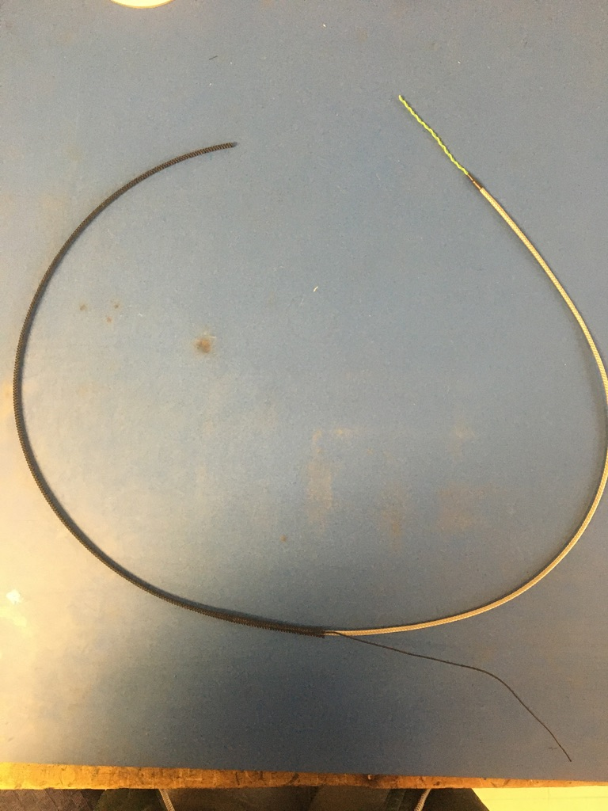
Put the plastic braid onto the wire harness. It does not matter from which end.

Slide 17
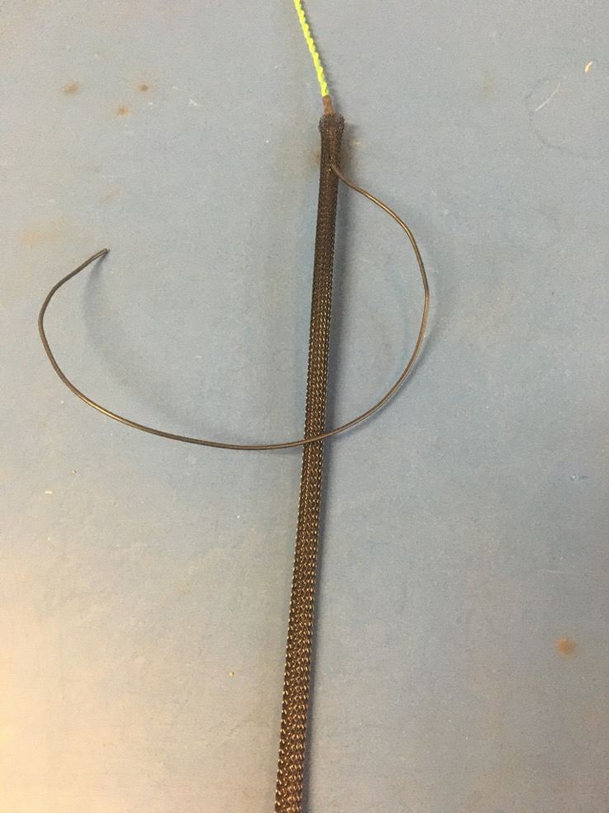
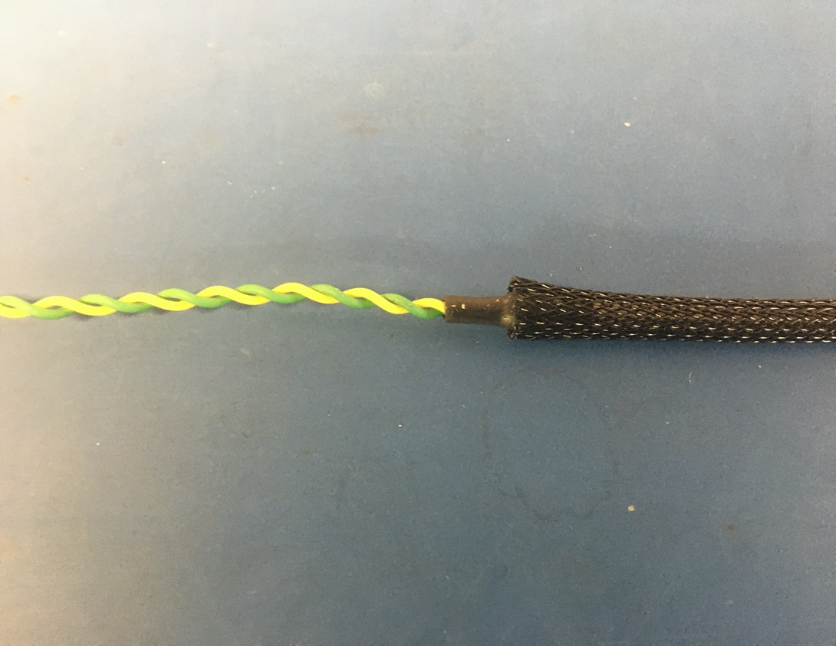
Thread the ground wire through one of the holes in the plastic braid so it appears as shown on the right. At each end of the harness, the plastic braid should end midway through the metal shrink tube joints.

Slide 18
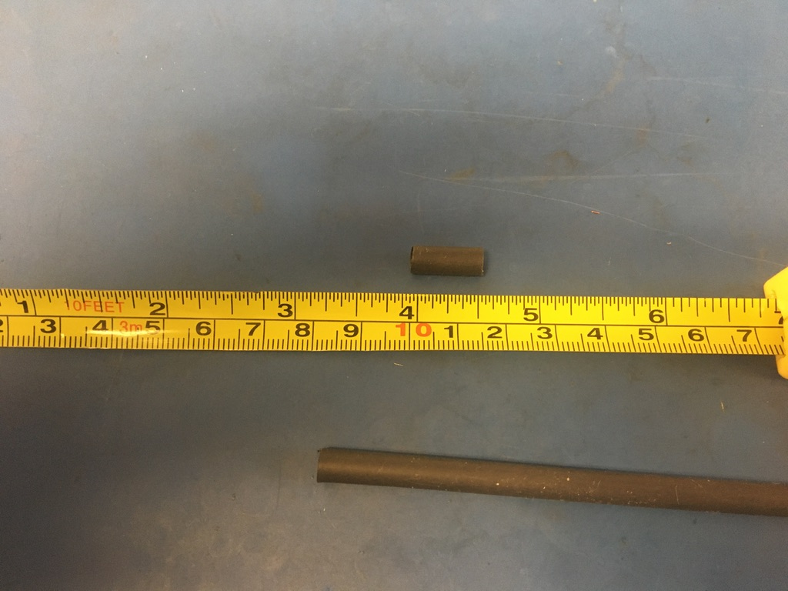
Measure out and cut one length of 6.4mm adhesive shrink tube that is .5in long.

Slide 19
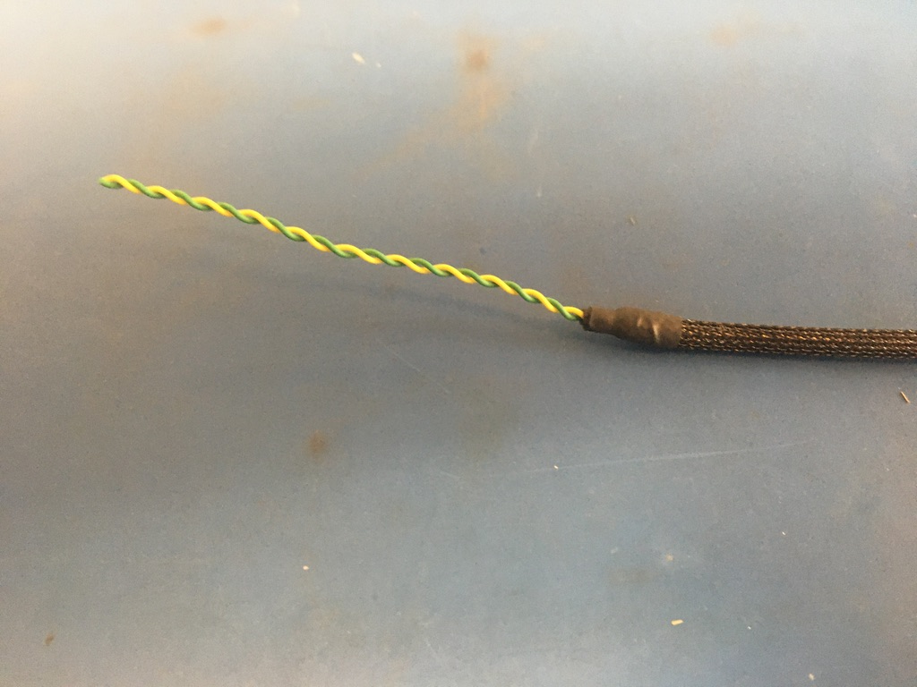
Place the piece of shrink tube onto the plastic braid end without the ground wire. The plastic braid should end midway through the piece of shrink tube. Apply the heat gun.

Slide 20
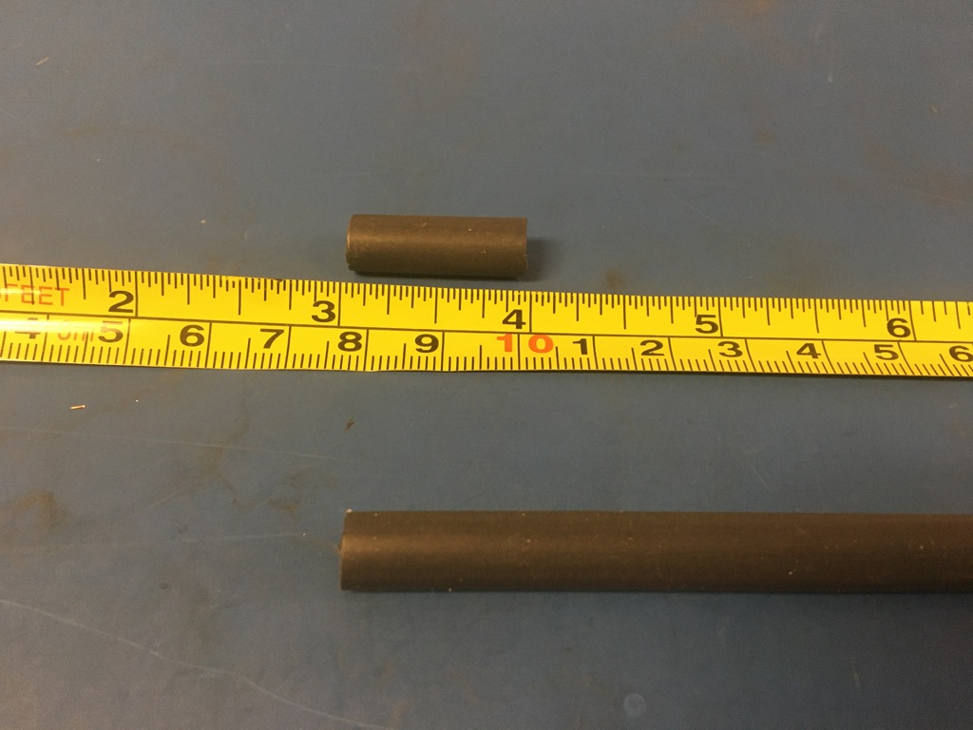
Measure out and cut one length of 6.4mm adhesive shrink tube that is 1in long.

Slide 21
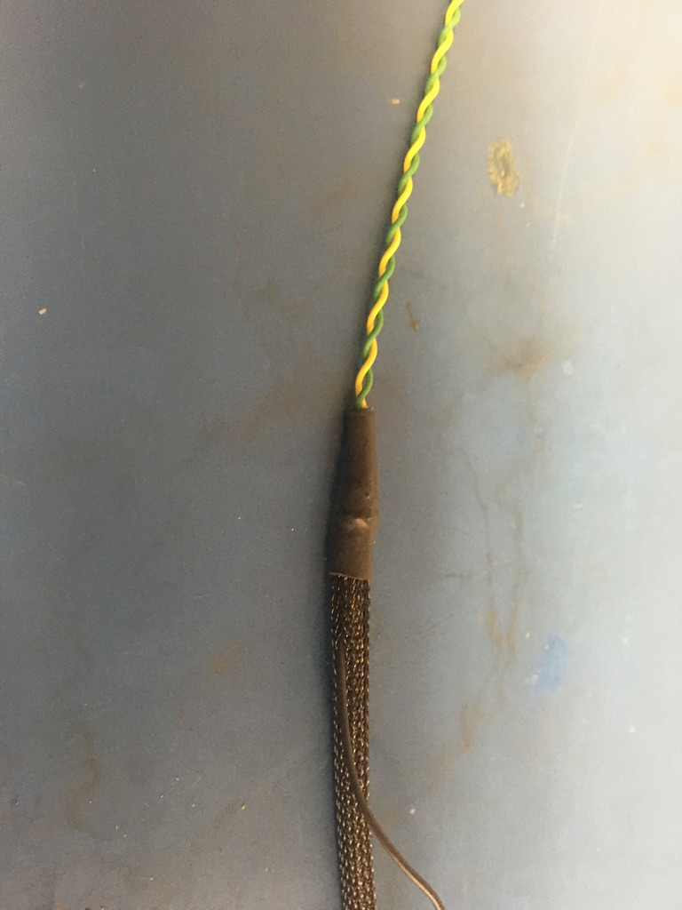
Place the piece of shrink tube onto the ground wire end of the harness. The shrink tube should be placed such that it covers the solder joint and the length of shrink tube beneath. Apply the heat gun.

Slide 22
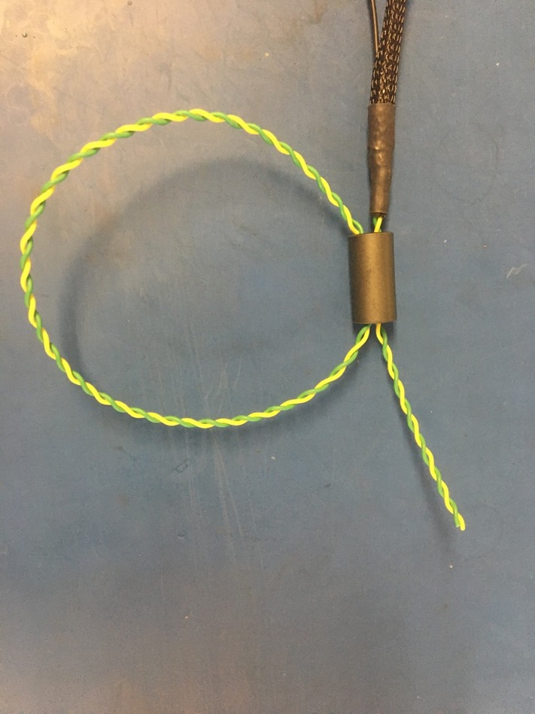
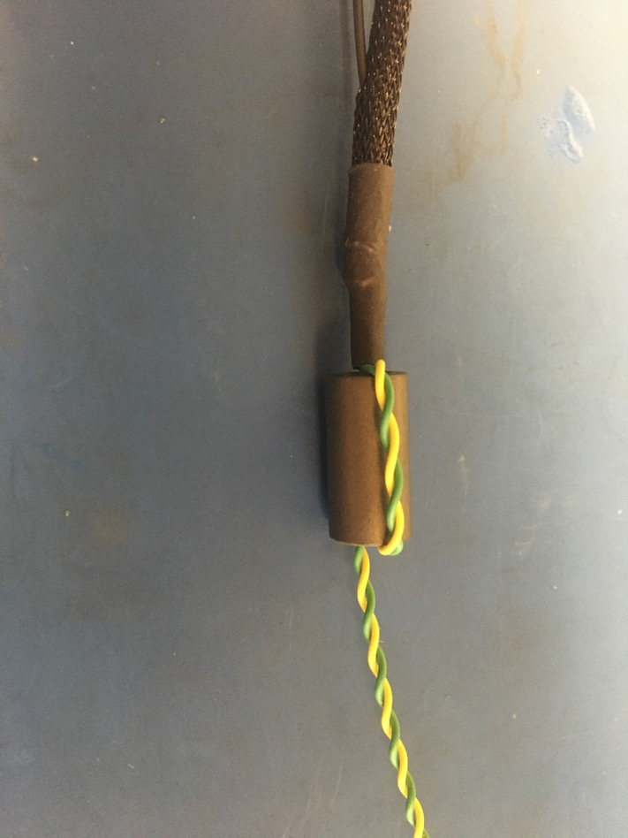
Thread the 75 magnet onto the end of the harness with the ground wire. Then thread the wires back through the bottom of the magnet as shown on the left. Pull the loop of wire taught so magnet appears as shown on the right.

Slide 23
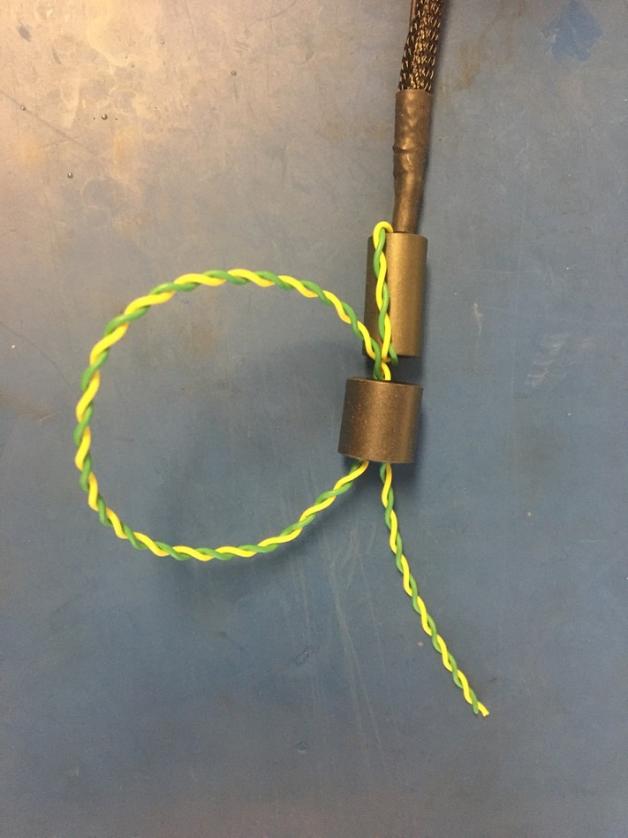
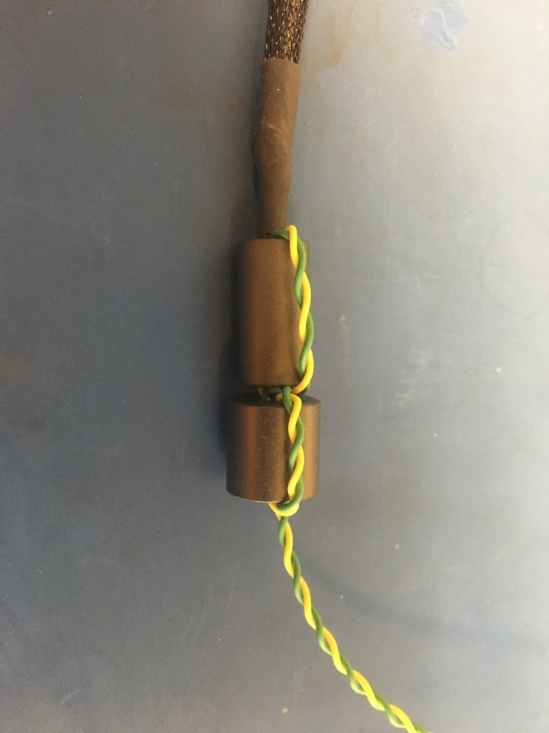
Thread the 43 magnet on just like the 75 magnet.

Slide 24
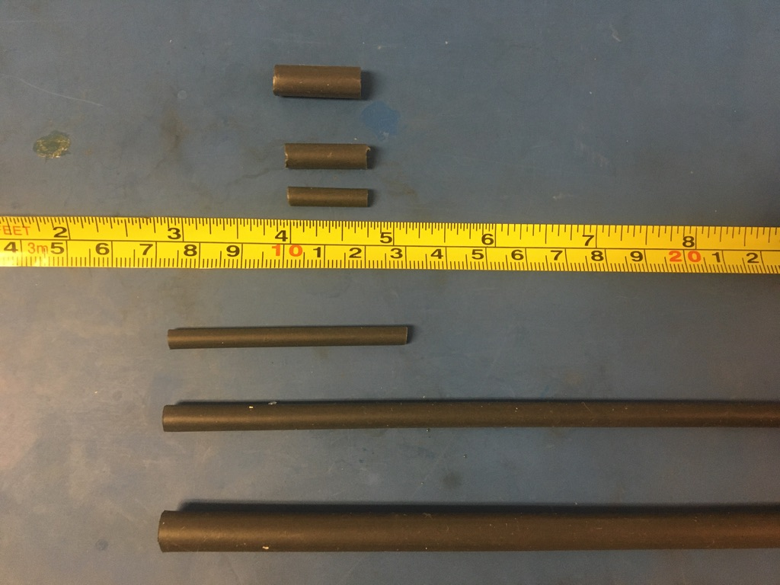
Measure out and cut 1in long lengths of 1/8th inch, 4.8mm, and 6.4mm adhesive shrink.

Slide 25
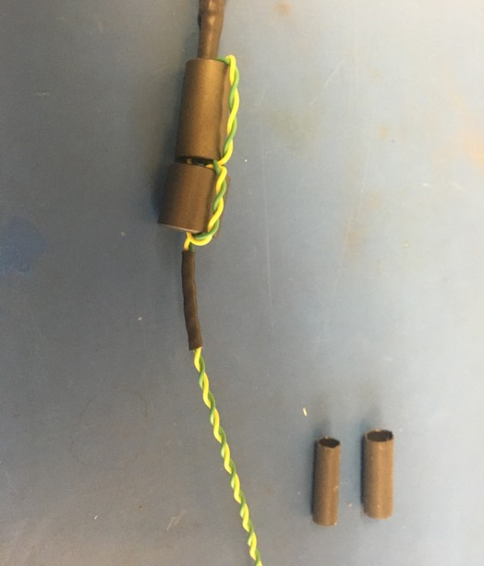
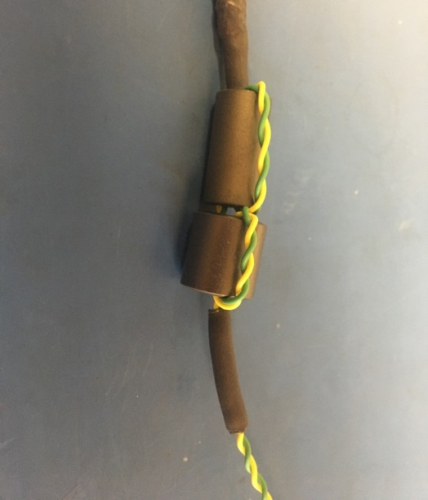
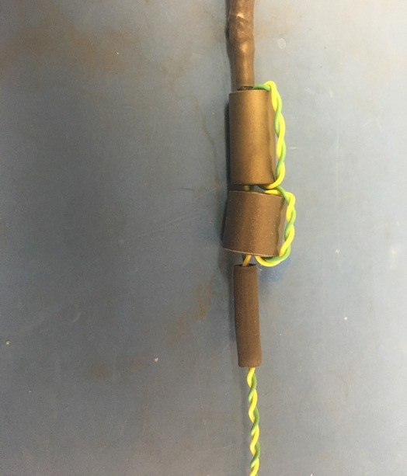
Place the 1/8th inch piece of shrink tube onto the wire harness such that it abuts the magnets. Apply the heat gun. Place the 4.8mm piece of shrink tube onto the wire harness such that it covers the 1/8th piece. Apply the heat gun. Repeat with the 6.4mm piece of shrink tube.

Slide 26
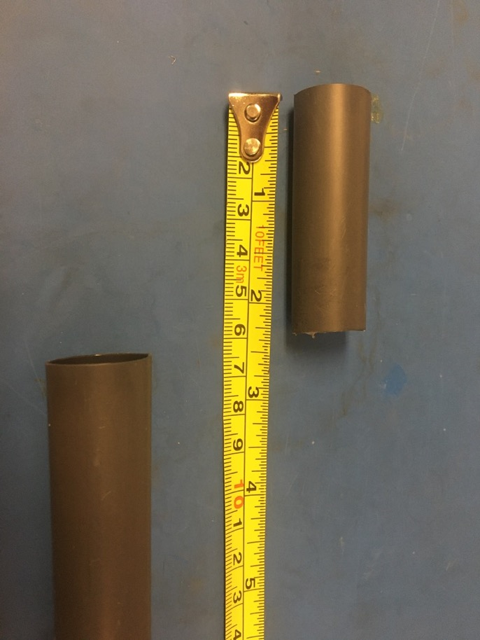
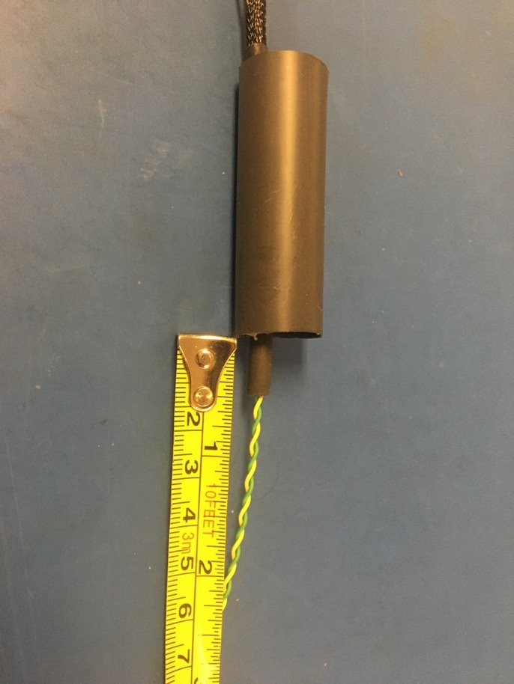
Measure out and cut one length of 16mm adhesive shrink tube that is 2.25in long. Place the piece of 16mm shrink tube over the magnets so that .5 inches of the shrink tube applied on the previous slide is visible as shown on the right.

Slide 27
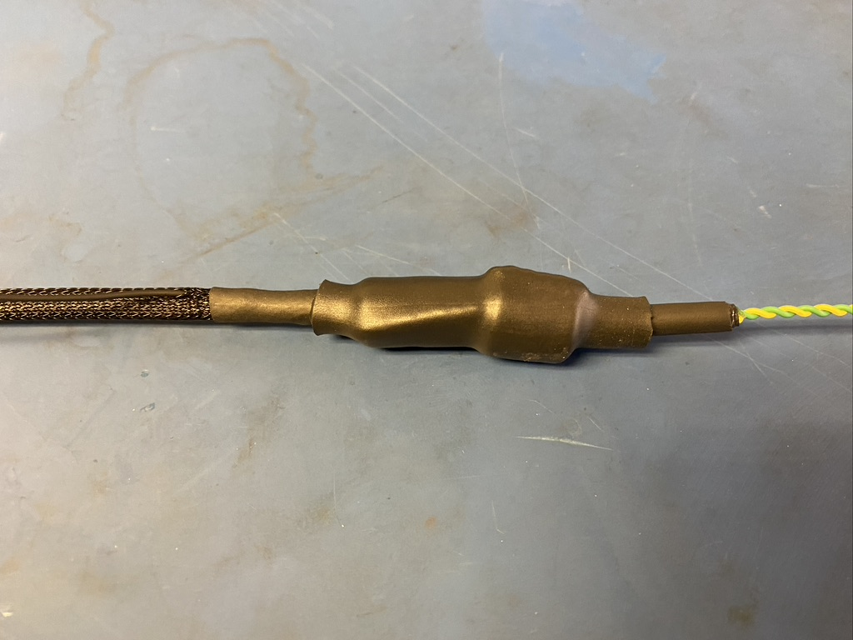
Apply the heat gun.

Slide 28
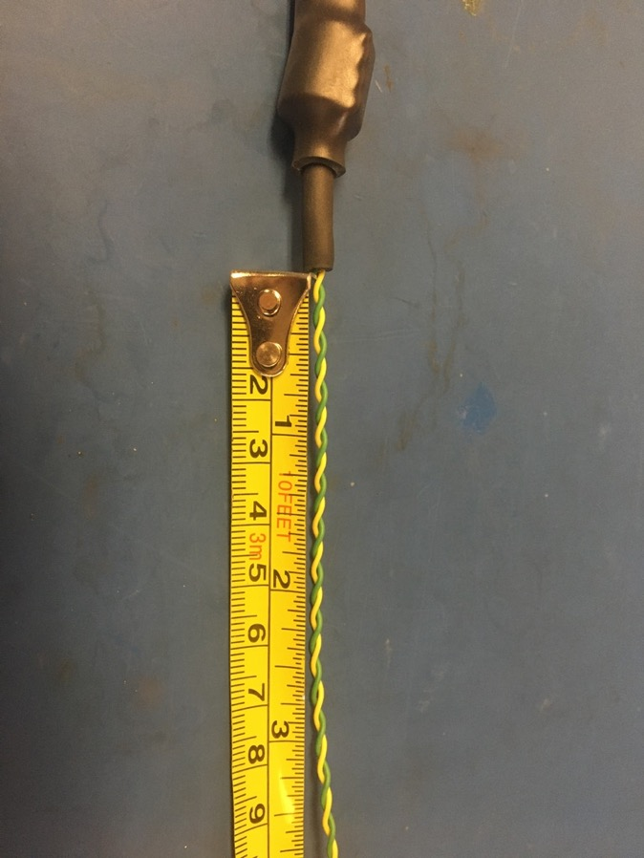
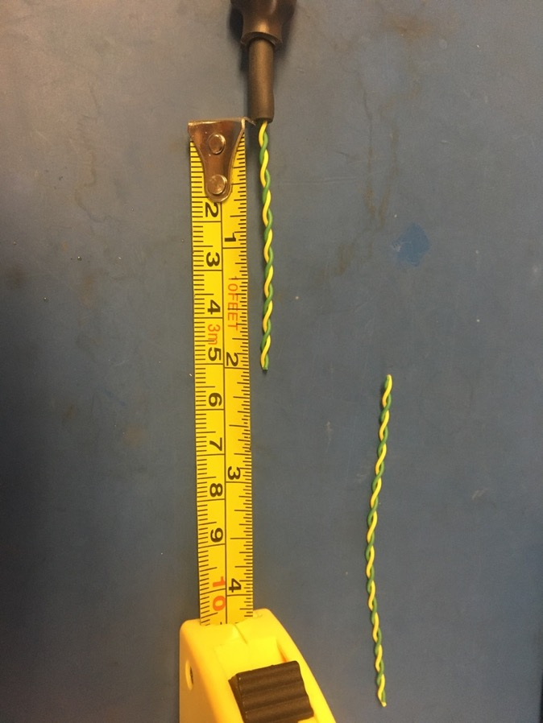
Measure and cut the twisted pair on the magnet end of the harness so that it measures 2 inches.

Slide 29
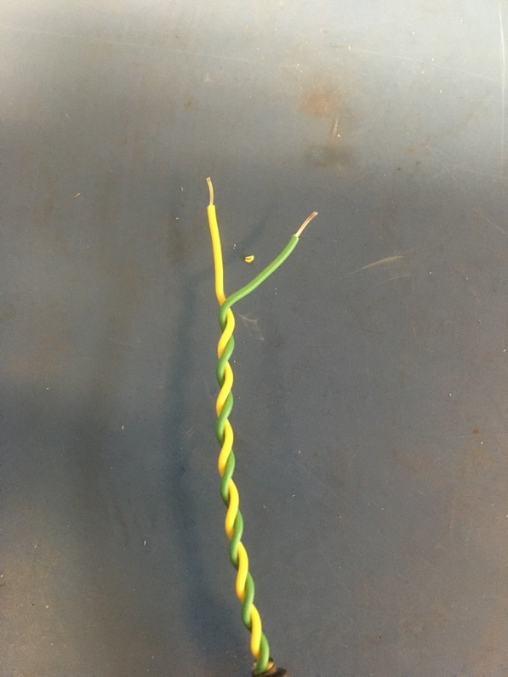
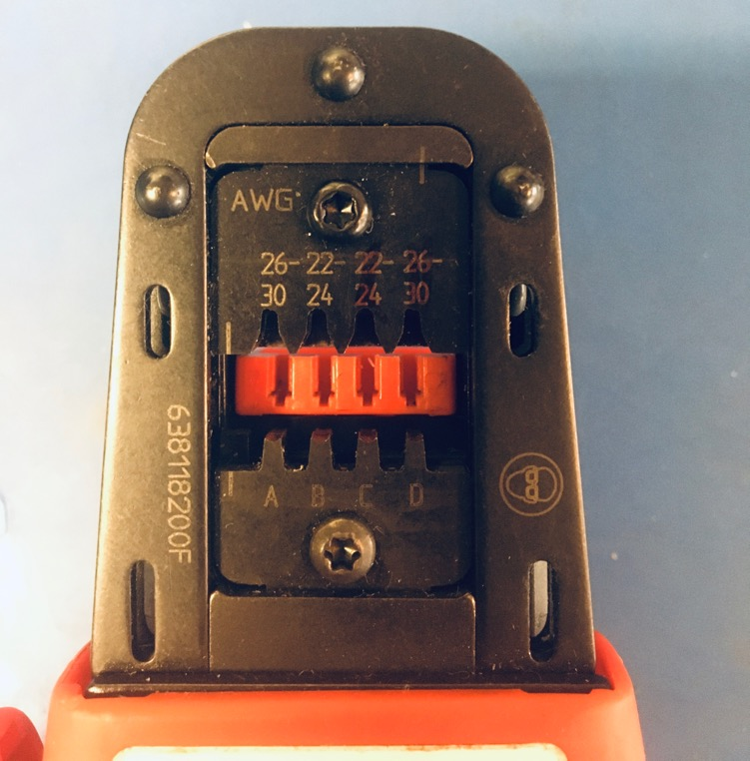
Strip the yellow and green wires (about 2-3mm) on the magnet end of the harness. Using the KK 254 crimper, crimp on the KK 254 tips. Be sure to use slot A on the crimper.

Slide 30
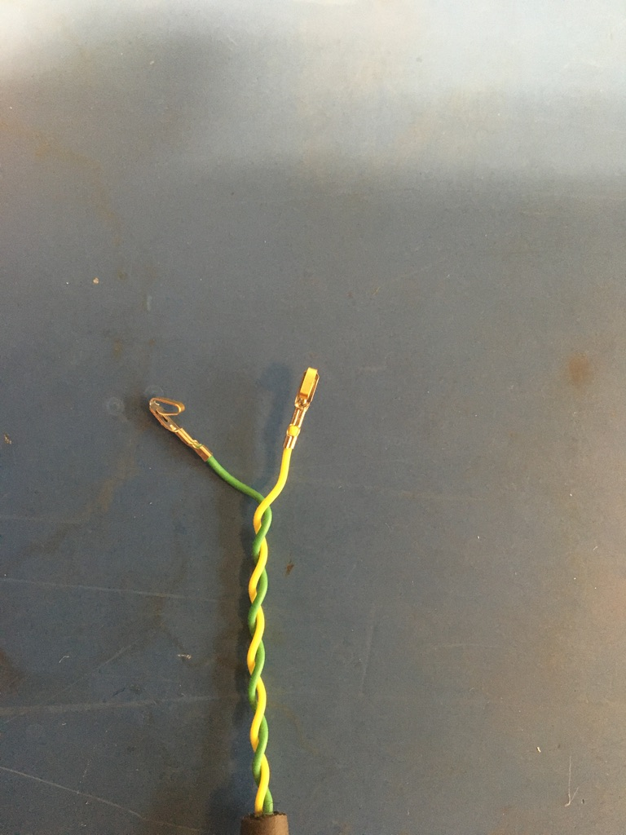
Once the wire ends are crimped, they should look as shown: isolation held by the first grip but not the second and a bit of exposed wire peaking out the end of the second grip.
Exposed wire just visible
Isolation in first grip

Slide 31
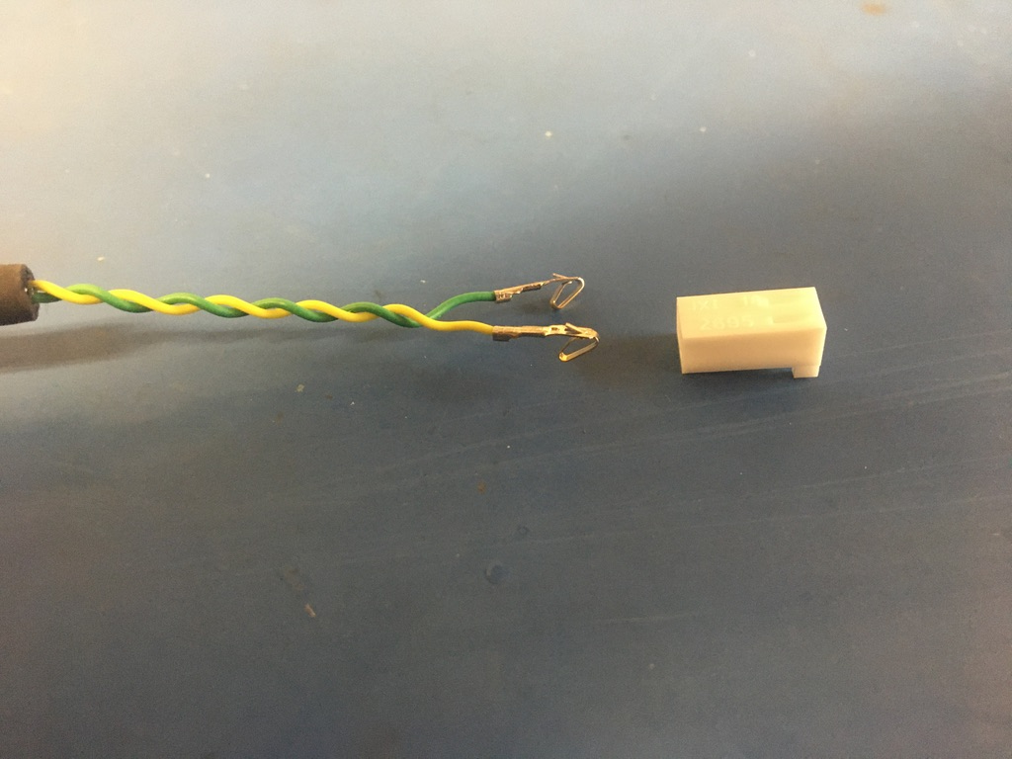
Before inserting the tips into the connector, have the extrusions of both face down.

Slide 32
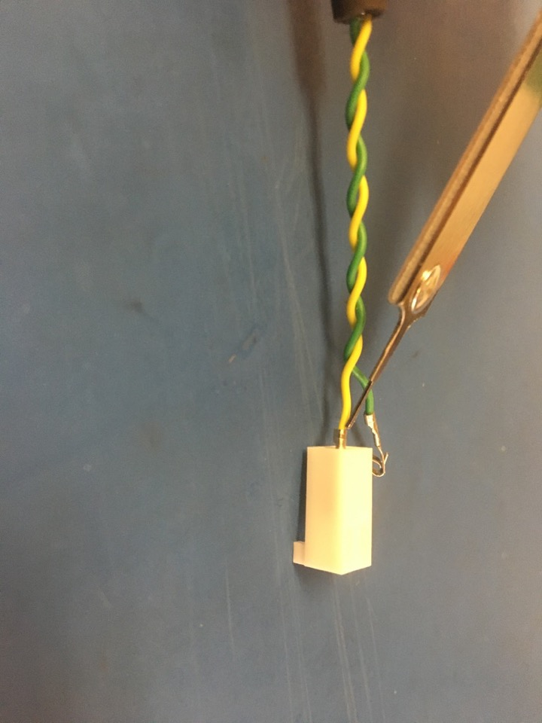
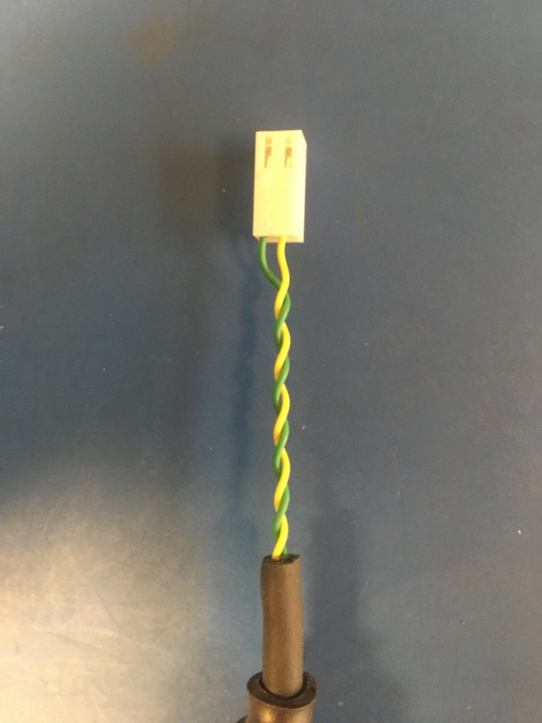
Insert the KK 254 tips into the KK 254 2 hole connector. Push each tip into the hole of the connector until it clicks. If there are difficulties with pushing the wire tip in by hand, use the metal extraction tool to push on the bottom edge of it until it clicks in place. The green wire goes in the hole on the left and yellow on the right.

Slide 33
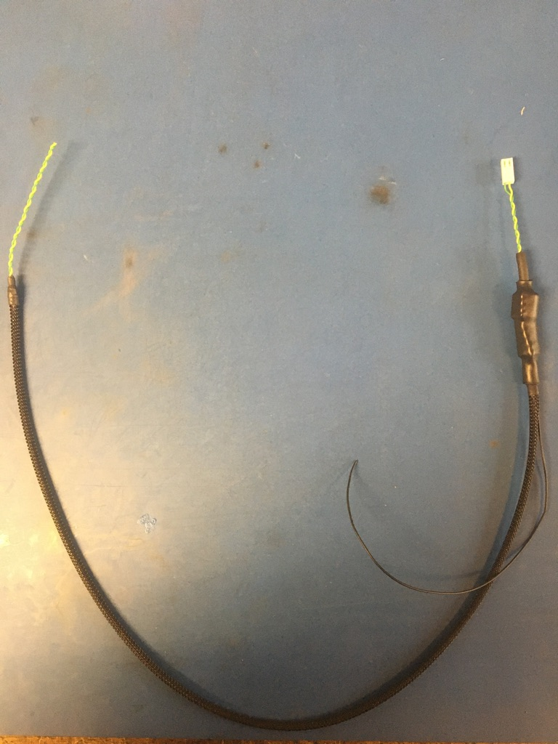
Part 1 of the wire harness complete! The ground wire will be given a tip later.

